Slide 1
English afternoon tea etiquette
By Piotr Markiewicz, 6b

Slide 2
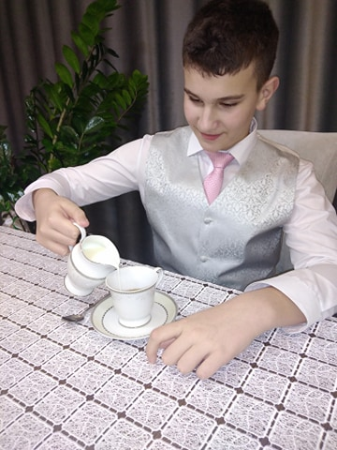
Pour the milk in first!

Slide 4
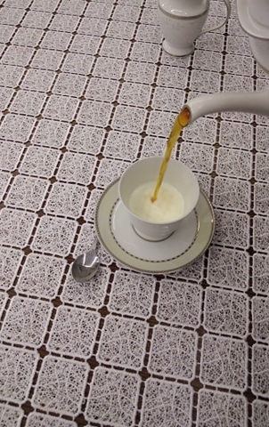
Then pour the tea for everyone at the table.

Slide 5
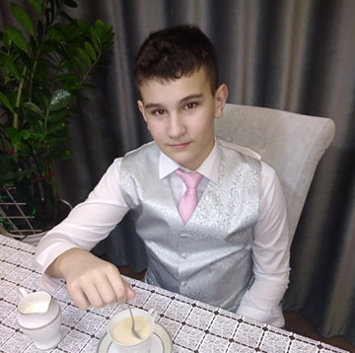
Tea should be stirred back and forth, not in circular motions!

Slide 6
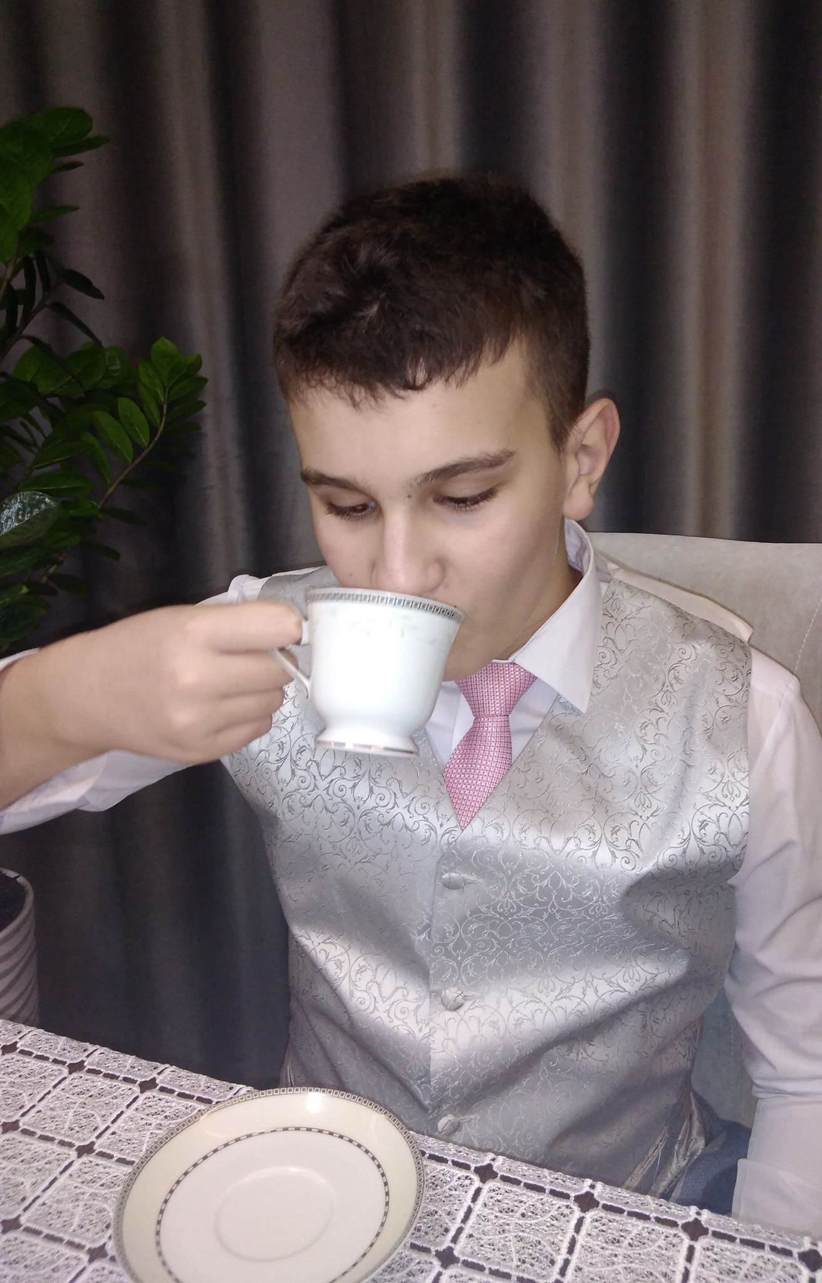
Tea cups should be held with your thumb and index finger meeting in the handle and the handle resting on your middle finger.

Slide 7
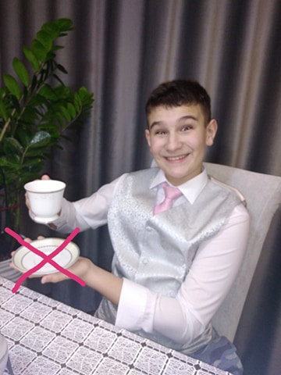
The saucer - never lifted from the table!

Slide 8
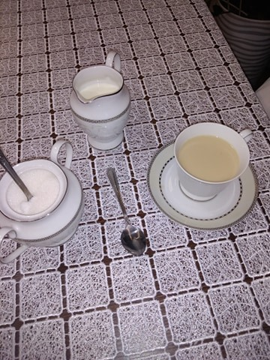
Bon appetit!

